Slide 1

Helpful logging with Python
Thomas Aglassinger
http://www.roskakori.at
v1.0.1

Slide 2


About me
Thomas Aglassinger
Software developer
  Industry experience since 2001 in various areas (health care, banking, e-commerce, customer relationship management)
  Casual open source developer
  2 x MSc
Links
  http://www.roskakori.at
  @TAglassinger
  https://github.com/roskakori

Slide 3

Motivation
Logging is part of non trivial software development
During debugging and tracking down support issues, developers (and others) spend quite some time looking at log files
Well described: technical aspects of logging
Not so much:
  When to use which log level?
  How to word log messages in a helpful way?
Source: https://commons.wikimedia.org/wiki/File:Light_bulb_(yellow)_icon.svg

Slide 4
Agenda
Take a look at each log level
  INFO
  ERROR
  CRITICAL
  WARNING
  DEBUG
When to use it?
Templates / guidelines for helpful log messages

Slide 5
Logging – the basics

Slide 6
Logging example
import logging
_log = logging.getLogger('example')
if __name__ == '__main__':
logging.basicConfig(level=logging.INFO)
_log.info('hello world!')
_log.debug('located at: %s', __file__)

Slide 7
Logging example
import logging
_log = logging.getLogger('example')
if __name__ == '__main__':
logging.basicConfig(level=logging.INFO)
_log.info('hello world!')
_log.debug('located at: %s', __file__)
Create a new logger
Log level INFO or
higher to console
Will be logged
Message includes
variable
Will be suppressed

Slide 8
Articles on Python logging
Good logging practice in Python
  The basics
  Configuration using JSON, YAML, INI
Get Started Quickly With Python Logging
  With PyCharm
  Formatting messages
Python Custom Logging Handler Example
  Log to Kafka streaming platform (to collect logs from multiple sources)

Slide 9
INFO logging

Slide 10
Motivation for INFO messages
Quickly see what application is doing right now (or was doing at a certain point in time)
Trace back what caused a certain error
High level
If possible using business terms (process, document, file, customer record, ...)
Small amount of messages to avoid information overflow and excessive impact on log storage

Slide 11
When to use INFO
With high level components: business relevant actions and decisions that influence the result
  Business process start / end
  Input received / output sent
  Major branches in process logic
With low level components: essential operations
  Incoming requests
  Start / end of transactions (database, files, network, …)
  Connection to other services or resources (database)
  Important state changes ( configuration changes, log in, session context, …)
  Start / end of complex calculation, important results
  Progress information (download, calculation, ...)

Slide 12
Example: basic logging
_log.info('processing customers from "%s"', customers_path)
line_number = 0
with open(customers_path, encoding='utf-8') as customers_file:
for line_number, line in enumerate(customers_file, 1):
process_customer(line)
_log.info('processed %d customers', line_number)
INFO:example:processing customers from ".../customers.txt"
INFO:example:processed 69 customers

Slide 13
Logging before / after the fact
processing customers from ".../customers.txt"
When the application is about to do something: use present tense participle (“-ing form”)
processed 69 customers
When the application finished doing something: use past tense

Slide 14
Perspective of log messages
Word log messages from the perspective of the application
I = the application
you = the reader of the log
In line with usability engineering (i.e. status messages, progress bars, error dialogs)

Slide 15
ERROR logging

Slide 16
Detecting errors
Detect yourself with „if“:
Detect error raised by called function using „except“:
if actual_value != expected_value:
…
try:
do_something()
except OSError as error:
...

Slide 17
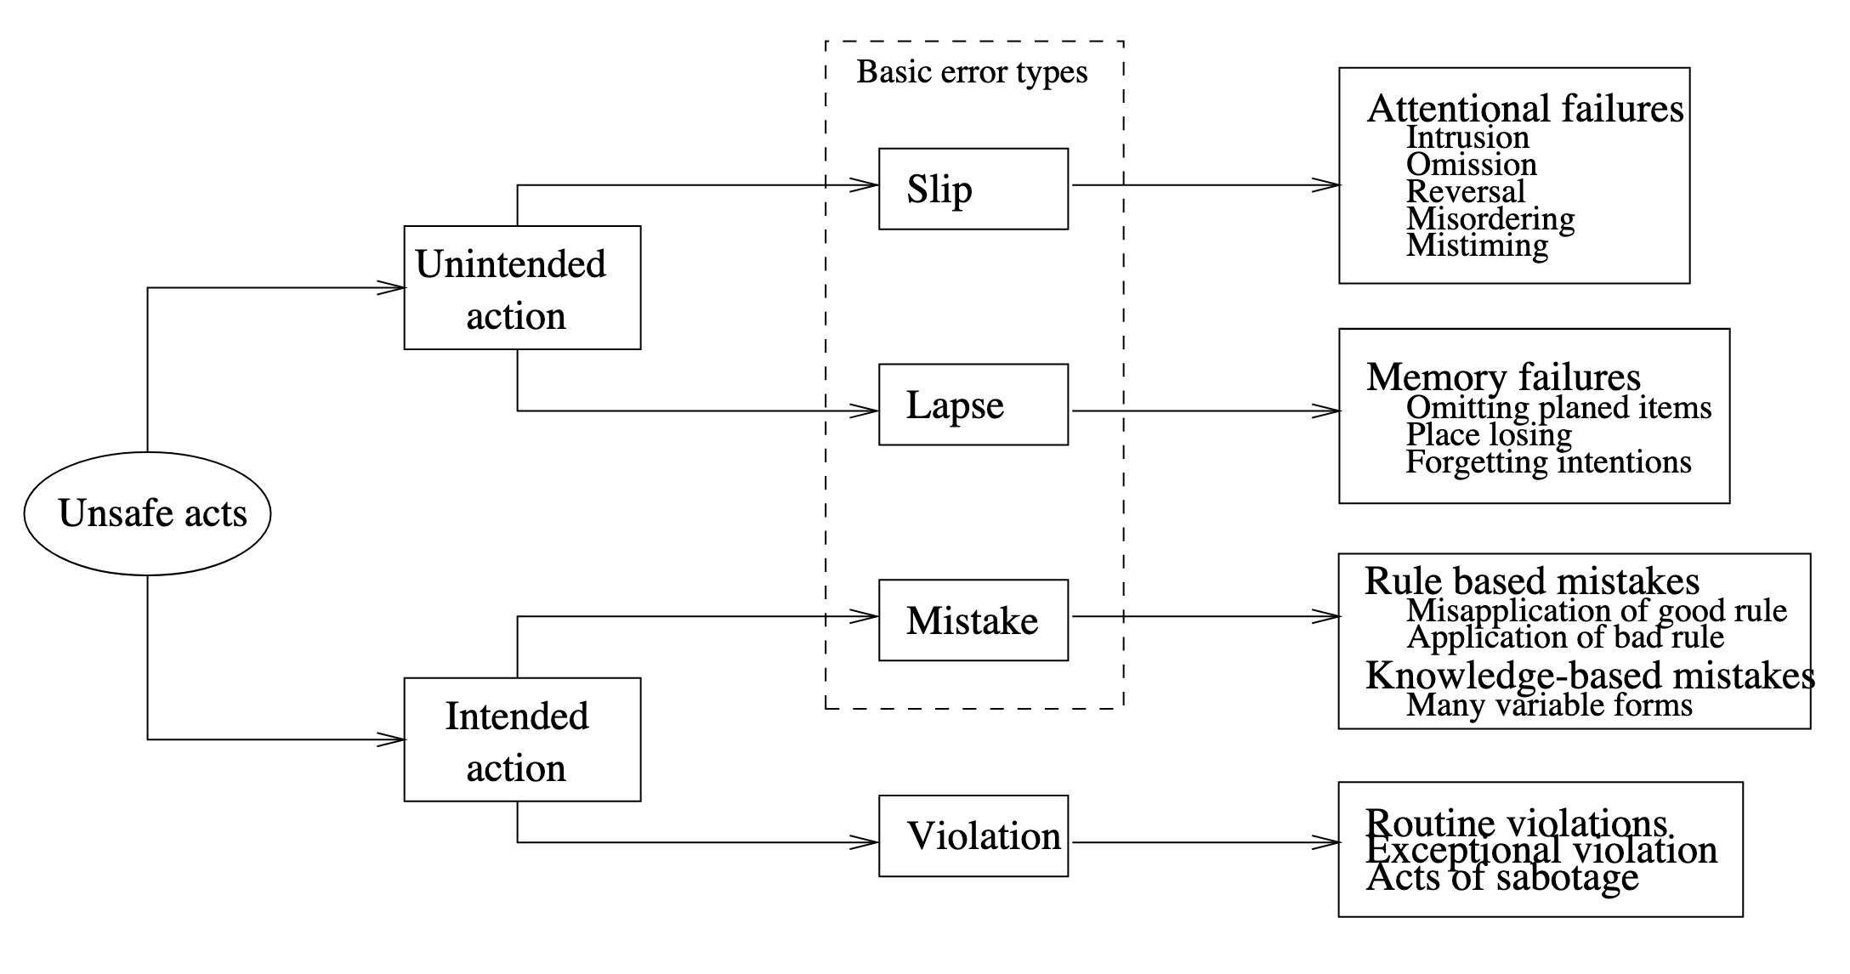
Human error as unsafe acts
Source: J. Reason (1990), „Human Error“, p. 207

Slide 18
Examples for unsafe acts
Slip: person does something they did not intent to and would know better, e.g. type “their” instead of “there”
Lapse: person forgets to do something they intended to do, e.g. exit application without saving
Mistakes: person "intentionally"carries out a sequence of actions that - maybe even possible and correct for the application - do not give them what they want, e.g. try to open text document in spreadsheet application
Violations: e.g. workaround, sabotage

Slide 19
Solving errors
Provide information for the log reader to reflect about the situation that lead to an error
State: spell out what the data where provided / processed
→ particularly helpful to detect slips and lapses
Context: spell out what the software actually was doing
→ particularly helpful to detect lapses and mistakes

Slide 20
Describing the error context
Message should describe the context in which the error was detected
Description should be self contained
  Object that caused error, e.g. file, customer number, session number
  Action that was attempted to be performed, e.g. reading, writing, calculation, creating, connecting, …
  Parameters or values that were attempted to be processed
Previous log messages should only help to find out how this context was reached

Slide 21
Template for error messages
Detect yourself with „if“:
Detect error raised by called function using „except“:
if actual_value != expected_value:
_log.error('some value is %s but must be %s',
actual_value, expected_value)
try:
do_something()
except OSError as error:
_log.error('cannot do something: %s', error)
For now just log.
Discussion on log vs raise: soon

Slide 22
Variants for „detect yourself“
Value cannot be processed: „some value is %s but must…“
  … be between 0 and 100
  … be one of: red, green, blue
  … match format YYYY-MM-DD
Value not found in a large set of possible values:
  „cannot find customer number 1234“
  „cannot find customer number 1234; possible similar customer numbers: 1243, 1324“
Missing required value:
  „date of birth must be specified“
  „data of birth must be specified for age validation“ (explains why value is required)
Unterminated context of recursive descent parsers:
  „string started in line 17, column 23 must be terminated with quote“
  avoid useless “unexpected end of file”

Slide 23
Log or raise error?
Log error: Few parts of the code will log errors
  __main__ before sys.exit(1)
  self contained request handlers / dispatchers that simply continue with next independent request
  form validation → show error and remain in form
Raising error:
  guidelines for wording error message apply
  can’t do anything about it anyway, just report it to the caller

Slide 24
Log and raise error: anti pattern
Spams log with redundant and thus confusing error messages
# BAD EXAMPLE, don't use this template
def process_customers(customers_path: str):
try:
with open(customers_path, encoding='utf-8') as customers_file:
for line in customers_file:
process_customer(line)
except OSError as error:
_log.error('cannot process customer data in "%s"', customers_path)
raise

Slide 25
Use exception chaining instead
Adds context information in new exception
Preserves existing information in chained exception
def process_customers_good(customers_path: str):
try:
with open(customers_path, encoding='utf-8') as customers_file:
for line in customers_file:
process_customer(line)
except OSError as error:
raise SomeError('cannot process customer data in "%s"',
customers_path) from error

Slide 26
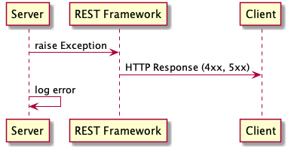
Log and raise error: valid scenario
Frameworks for REST API that convert exception into HTTP response:
  Server raises exception
  REST Framework converts
  exception into 4xx or 5xx
  HTTP response and thus
  reports error to the client
  Unless server also logs exception, information about error would only be available to client

Slide 27
Further reading on error handling
Lösungsorientierte Fehlerbehandlung (with Python)
How to write good error messages (with many examples)

Slide 28
CRITICAL messages

Slide 29
Critical errors
When application has to exit in unclean manner
  Resource leaks
  Data loss
Typical before involuntary server shutdown
Inappropriate for:
  Unprocessable single request / command / user input
  Errors during program startup, e.g. missing command line option or broken syntax in configuration file

Slide 30
Wording critical messages
Messages worded similar to ERROR
Example:
CRITICAL: cannot reconnect to database some.db: <some database error>
INFO: shutting down server

Slide 31
WARNING messages

Slide 32
Warnings hint at design issues
INFO is „good“
ERROS is „bad“
WARNING is …?

Slide 33

Warnings hint at design issues
INFO is „good“
ERROS is „bad“
WARNING is …?
Warnings delegate the decision if something is good or bad from the software designer to the user / log reader

Slide 34

But still...
Warnings can be useful under certain circumstances
In general: situations where an error can be fixed by the application
  In a deterministic way
  With a high probability it is what the user wants to do

Slide 35
Wording warnings
Mix of error and info should reflect in the wording
Error part: describes what happened and was expected
Info part: describes what is being done / has been done to improve the situation

Slide 36
Transient errors
External errors that might be going away after a while because the cause went away
Might be able to solve with retries
Example:
WARNING:example: Cannot connect to database some.db, trying to reconnect (attempt 2 of 5)

Slide 37
Reduced quality of service
In environment with multiple redundant components that can perform the same task
Example:
  replicas of search platform
  stateless micro services
request

Slide 38
Reduced quality of service
In environment with multiple redundant components that can perform the same task
Example:
  replicas of search platform
  stateless micro services
Example:
request
WARNING:example: Cannot connect to search server abcd17. Temporarily removing server from pool and delegating request to server abcd18

Slide 39
DEBUG messages

Slide 40
Debug messages
Target audience
  debug: developers familiar with the code
  any other log level: devops, operations, users, …
Wording
  if possible similar to INFO
  otherwise: whatever rocks your boat
    names of classes, methods, variables
    dumps of XML, JSON, request headers
    escaped string, hexadecimal garble
    ...

Slide 41

Amount of information
On other log levels, numbers of messages was as small as possible
Debug messages can be many because the application normally does not run with log level set to DEBUG
Source: https://knowyourmeme.com/memes/zerg-rush

Slide 42
Enabling debug logging
Only temporarily while tracking down an issue
Otherwise: too much strain on storage and collection of logs
Enable only for loggers that are expected to contain relevant information
Consider adding a mechanic to your application that allows to change log levels during runtime

Slide 43
Conclusion

Slide 44
Summary
INFO:
  “doing” vs “did“
  Focus on business logic
  Keep amount of messages low
ERROR:
  “cannot do something: something must be something else“
  Log vs raise, avoid log and raise
CRITICAL: like error but only if the application cannot recover
WARNING
  Might hint at design issues
  Few valid situations
  Combines error and info message
DEBUG
  For developers
  Log whatever is necessary

Slide 45
Questions and answers
Thomas Aglassinger
http://www.roskakori.at
@TAglassinger

